Slide 1
Address Security
Chapter 4

Slide 2
Learning Outcomes
Define the use of DHCP by simulating it in an enterprise network
Explain DHCP snooping and implement mitigation using simulation tools

Slide 3
DHCPv4
Manual Allocation
  The administrator assigns a static IPv4 address to the device
Automatic Allocation
  DHCPv4 automatically assigns a static IPv4 address from a pool of available addresses permanently to a device.
Dynamic Allocation
  DHCPv4 dynamically assigns, or leases, an IPv4 address from a pool of addresses for a limited period of time chosen by the server, or until the client no longer needs the address.
  This method is the most commonly used.

Slide 4
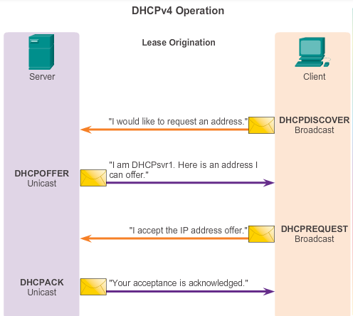
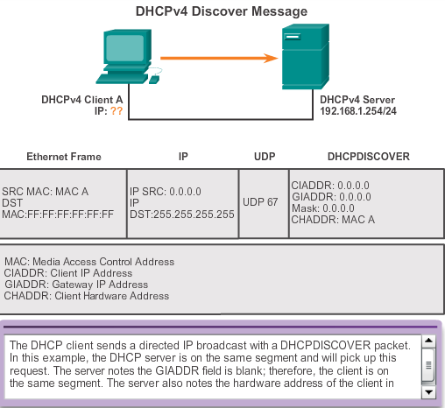
DHCPv4 Operation

Slide 5
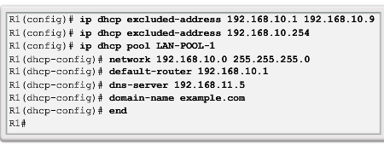
Configuring DHCPv4
A Cisco router can be configured to act as a DHCPv4 server. To configure DHCP:
  Exclude reserved addresses from the pool.
  Set up a DHCP pool name.
  Define the network and subnet mask. Use the default-router command for the default gateway. Optional parameters – dns server, domain-name.
Verify configuration by “show running-config”

Slide 6
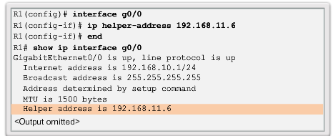
DHCPv4 Relay
To relay a DHCP request beyond the subnet, the router interface receiving the DHCP request needs to be configured with a “helper address” pointing to the DHCP server.
Interface receiving the DHCP request DHCP server IP
check
Notes:
10.1.2.3 DHCPv4 Relay

Slide 7
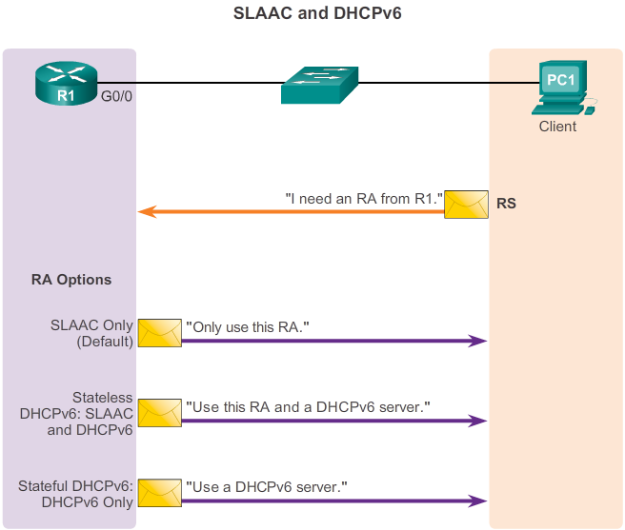
How about DHCP in IPv6?
The client PC will send a Router solicitation asking for a Router Advertisement containing important information like IP addresses, gateway and server options
RA can be given through SLAAC, DHCPv6 or a combination of both.
Router Advertisement options to be determined by 2 flags:-
“M” and “O”

Slide 8
SLAAC
Stateless Address Autoconfiguration (SLAAC) is a method in which a device can obtain an IPv6 global unicast address without the services of a DHCPv6 server.
Stateless means that the method does not require a dedicated server to provide information.
After receiving the RA, Client can generate its unique interface ID using EUI-64 process or randomly generated.
Then the client will check for duplicate address in the network using the DAD multicast.

Slide 9
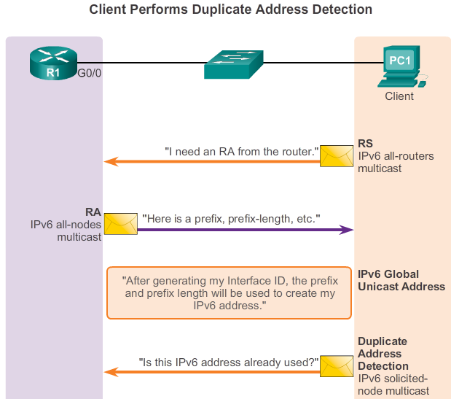
Pure SLAAC operation
Purely SLAAC, both M (managed config) flag and O (other config) flag are set to 0 (by default)

Slide 10
Configuring SLAAC
R1(config)#ipv6 unicast-routing
Activates IPv6 on Router
R1(config-if)# ipv6 addr 2001:DB8:0:20::1/64
Assign the initerface with the global prefix with which the clients will derive their interface ID with
R1(config-if)#ipv6 enable
Enable ipv6 on the interface
Both M and O flags are = 0
Packet tracer example

Slide 11
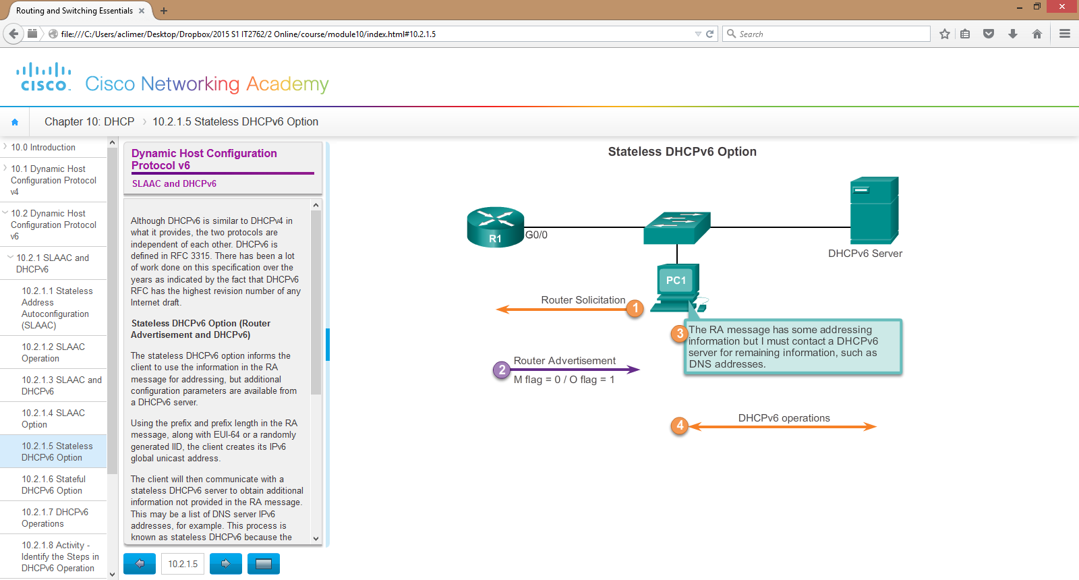
SLAAC with Stateless DHCPv6 mode
The IP address is still generated by the client with the prefix given by the router. Other information can be obtained thro the server

Slide 12
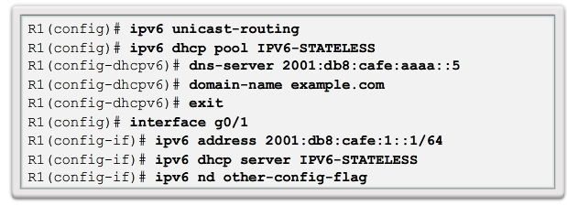
Configuring SLAAC with Stateless DHCPv6 Server
Defines where to find the DNS server for other info
M flag is 0. O flag is 1
https://www.youtube.com/watch?v=irtbIo0Nxuw

Slide 13
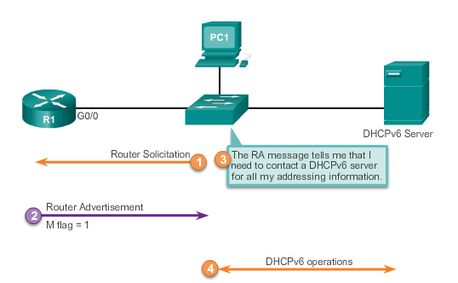
Stateful DHCPv6
All IP addresses and information are obtained from a DHCP server

Slide 14
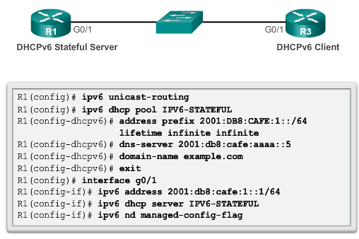
Configuring Stateful DHCPv6
Note: the router acts as a DHCPv6 Server. You may have a dedicated server which issues IPv6 addresses to Clients.
M Flag is 1
Create DHCP Pool from which IP addr are given out to the clients and all other information
Set flag to receive IP address from a DHCP server

Slide 15
DHCPv4 Attacks
DHCP Starvation Attacks
Rouge DHCP Server Attacks

Slide 16
DHCP Starvation Attack and Mitigation
The attacker may use attack tools like Gobbler/Yersinia to request for all the available DHCP addresses in the server’s pool by using spoofed mac addresses.
Once the pool is exhausted of all the IP addresses, when a new request for IP comes along by a legitimate user, the user is denied of the DHCP service.
This is a kind of DoS attack using DHCP Leases
This is an example of a DHCP starvation attack done https://www.youtube.com/watch?v=jiSl89al4nI
These attacks are mitigated by simply configuring Port security to only allow maximum 1 MAC address per switchport interface.

Slide 17
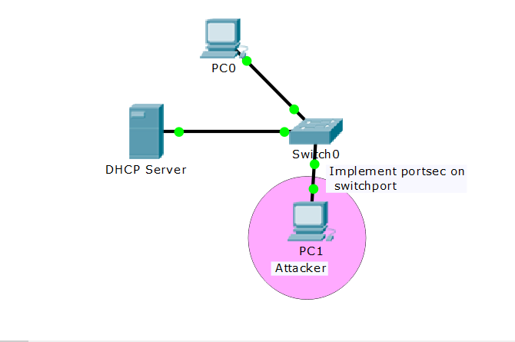
DHCP Starvation Attack and Mitigation
The attacker, with the installed tool will launch the DoS Attack to starve the pool of IP addresses at the DHCP server.
Usually after the server is compromised, a rogue server is setup to issue fake IP addresses

Slide 18
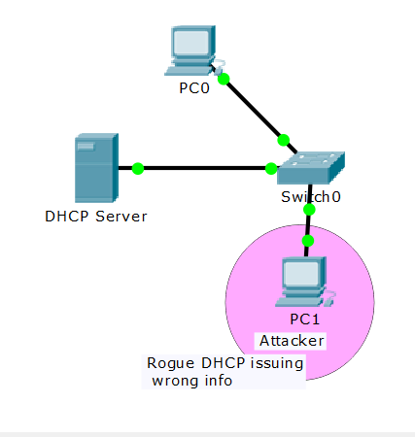
Rogue DHCP Server Attack
Attacker pretends to be a DHCP server issuing wrong IP Addresses, Default Gateways and DNS to clients.
If client takes up the new IP address and default gateway, all packets destined to the outside network will then pass through the Rogue server, compromising confidentiality.
To mitigate implement portsec to allow max 1 MAC address only
Another mitigation is DHCP snooping configuration

Slide 19
Rogue DHCP Server Mitigation
R1(config)# ip dhcp snooping vlan 4
Enable DHCP snooping on VLAN 4. You can also simply leave it as ‘ip dhcp snooping’ and it will activate it on all.
Identify which port you can trust to receive DHCP responses like OFFER, ACK,NAK.
R1(config-if)# ip dhcp snooping trust
On the trusted ports (the port connected to the DHCP server) enter the above command
R1(config-if)# no ip dhcp snooping trust (default)
R1(config-if)# ip dhcp snooping limit rate 10 (pps)

Slide 20
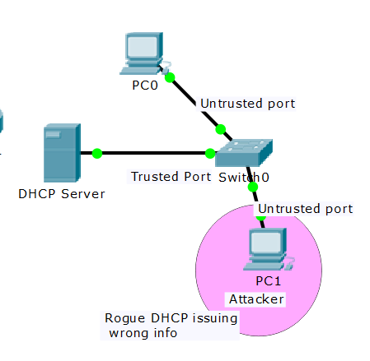

Rogue DHCP Server Mitigation
When snooping is enabled on the switch, by default all ports in the VLAN are untrusted
Trusted ports are usually the ports connected to the DHCP server
Verify using “show ip dhcp snooping bindings” command on the switch

Slide 21
DHCPv6 Attacks and Mitigation
Similar to DHCPv4, DHCPv6 is also susceptible to rogue server attacks and thus needs definition of trusted and untrusted ports on the switch.
The RA Guard and RA throttling commands help identify the trusted ports on the switch and control unnecessary traffic on the ports.
You may read the text “Configuring IPv6 Client Address Learning” by Cisco for more information.

Slide 22
THE END

